Slide 1
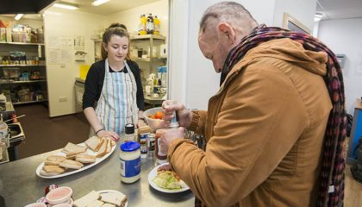

The Problem:
Lower levels of volunteering work within the community.
Implemented Features:
Charities registration: name, location, contact details and base requirements.
User registration: name and contact details.
Users presented with opportunities fitting their preferences.
Charities can view applicants for their opportunity.
Google maps of charity location.
Future Projects:
Expansion out from Bath into alternative markets
Subscription service for larger volunteering agencies
Donation Systems
All users to promote themselves on the platform.
Optimized search algorithm for matching user and volunteering agencies
The Solution:
Direct communication between volunteering agencies and students in the local area looking to further their career
Non-implemented Features:
Preference filtering and sorting.
Multiple opportunities per charity.
Addition information for application process.
Customisation of personal details after registration
Applicants list for charities

Slide 2



Name:
Lucy
Occupation:
1st Year Student at University
Age:
19
Enjoyed doing volunteering work during her Gap Year. Struggling to find a volunteer opportunity in Bath.
Name:
Elijah
Occupation:
1st Year Student at University
Age:
18
Regrets not taking a gap year and wants to volunteer in the local area to fill out his CV.
Name:
University Careers Department
In order to secure the brightest future possible for their students, volunteering opportunities are pushed onto students for a chance to grow and promote themselves in their future life and CVs.

Slide 3
User Homepage
Search through volunteering agencies advertising. Advertise yourself on the platform.
Registration:
Charity or User?
Charity Homepage
Add volunteering opportunities to the list for users to see. See all applicants for position.

Slide 4
